Slide 1




Center for Real Estate Strategies Conference Presentation:
Insights into Commercial Real Estate Investment Returns
Mark J. Eppli
Professor of Finance and Bell Chair in Real Estate
September 18, 2017

Slide 2

Researchers:
Mark J. Eppli, Professor of Finance and Bell Chair in Real Estate, Marquette University
Charles C. Tu, Daniel F. Mulvihill Professor of Commercial Real Estate, University of San Diego
Research Purpose:
Using NCREIF Data:
  Determine holding period returns for commercial real estate
  Explain ex-post holding period returns using ex-ante attributes

Slide 3
Determine holding period returns (i.e. total property returns). . .
. . . . .across the five major property types,
. . . . . after adjusting for risk,
. . . . . across geographic area, and
. . . . . across market employment size/growth

Slide 4
. . . . using the best data in the industry . . . .
The NCREIF NPI Index
Quarterly data
Income and appreciation components
By property type (office, industrial, retail, hotel and apartment)
By regions of the U.S. and at the MSA
2016Q4 market value of half a trillion dollars and over 10,000 properties
Limited to institutional property owners and mainly core assets
Appraisal-based

Slide 5
. . . . apartments outperform holding period returns and risk-adjusted returns for 3, 5, 7, 10, and 15-year holding periods . . . .

Slide 6
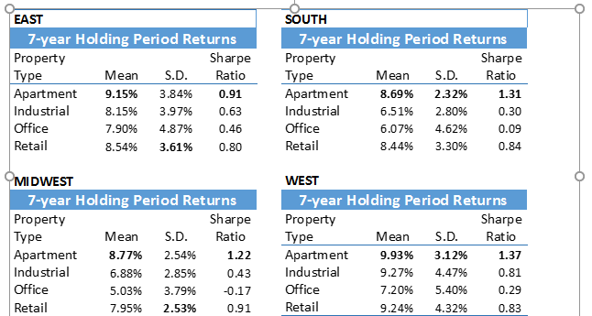
. . . . apartment returns also best other property types across regions of the U.S. . . . .

Slide 7
. . . . estimating returns by city tier . . . .

Slide 8
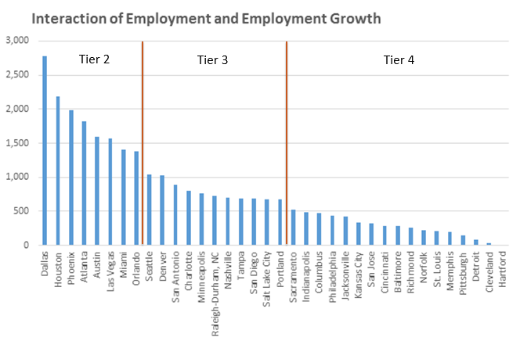
. . . . using employment to determine city tier . . . .

Slide 9
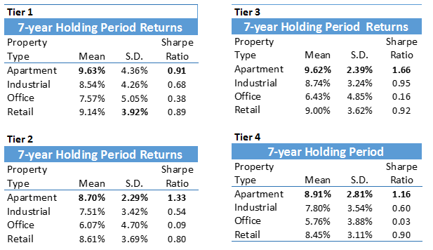
. . . . across city tiers apartment returns are consistent and superior . . . .

Slide 10
. . . . apartment returns have low volatility across time . . . .

Slide 11
Audience question . . . .
What do you think the breakdown is between income and appreciation for the seven year holding period analysis for all NPI properties:
7% income and 1% appreciation
6% income and 2% appreciation
5% income and 3% appreciation
4% income and 4% appreciation

Slide 12
. . . . apartment and retail provide some inflation hedge with inflation averaging 2.7% during the analysis time period . . . .

Slide 13
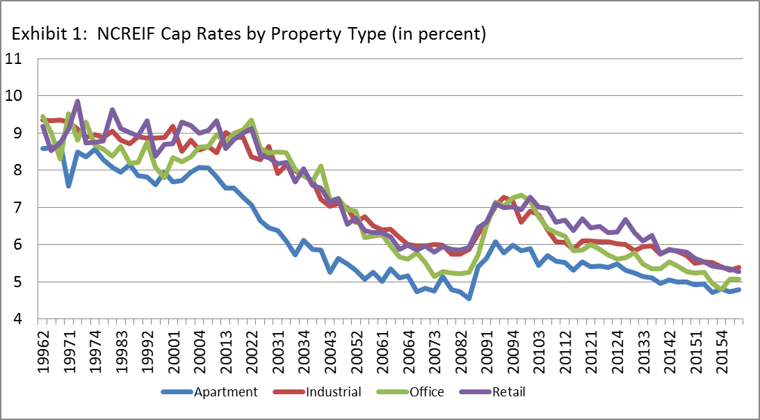
. . . . how can industrial, office, and hotel appreciation rates be near zero or negative during a period of cap rate compression?

Slide 14
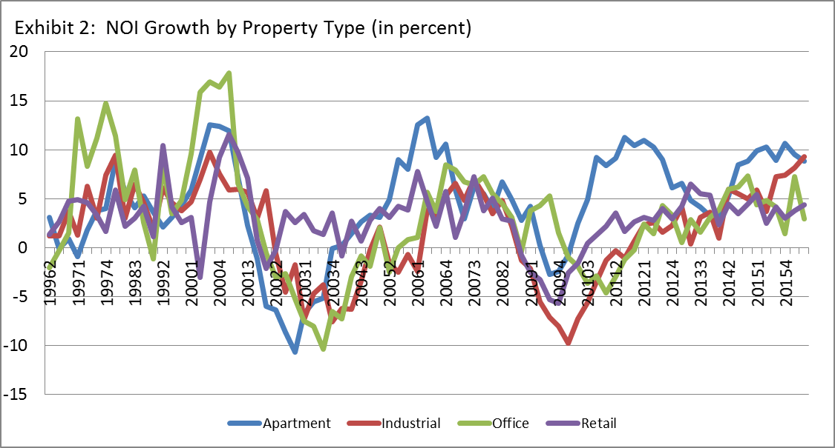
. . . . and with generally positive NOI growth?

Slide 15
. . . . capital expenditures is consuming property appreciation . . . .
Source: NCREIF data used in “New NCREIF Value Index and Operations Measures,” Michael S. Young, Jeffrey D. Fisher, and Joseph D’Alessandro, Journal of Real Estate Literature, 25:1 (2017), 221-235.

Slide 16
. . . . holding period returns including and excluding Cap. Ex. . . . .

Slide 17
Key Takeaways
Apartment returns dominate the other property types when measuring
  Unadjusted returns
    Risk-adjusted return
    Across geographic region
    Across city tiers
Apartment and retail properties are an anecdotal hedge for inflation
Apartments and retail have the lowest ratio of Annual Cap Ex to Property Value of the property types

Slide 18


