Slide 3
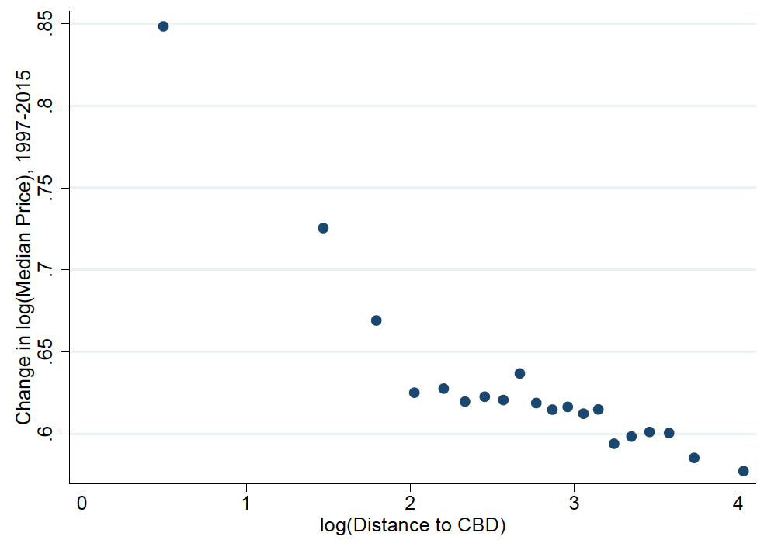
The Great Pro-City Price Tilt (U.S.)
Hipsman (2015) Using Zillow Sub-city

Slide 6
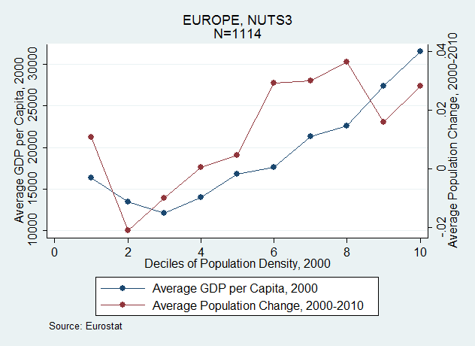

Slide 8
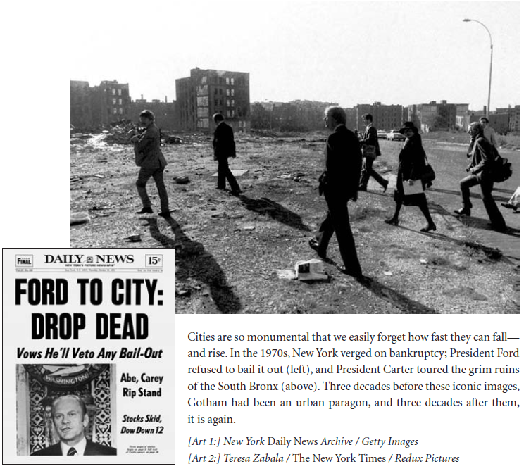
Alfred Peet
Photo by Postdil

Slide 10
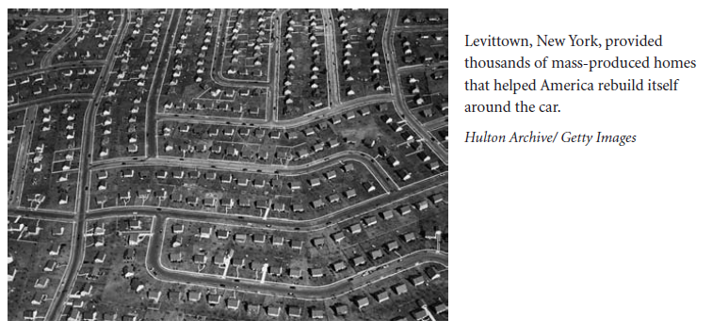
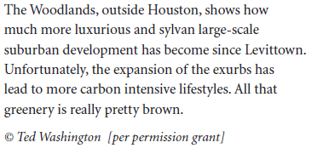
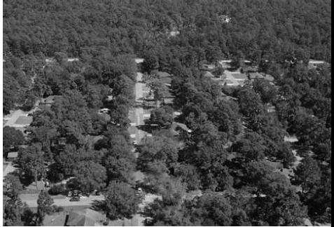

Slide 11
Density and Income in Manhattan

Slide 15
Agonies of Success: Inequality

Slide 16
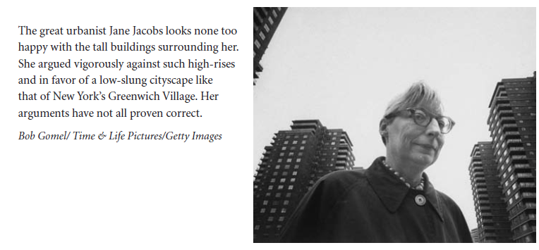

Slide 17
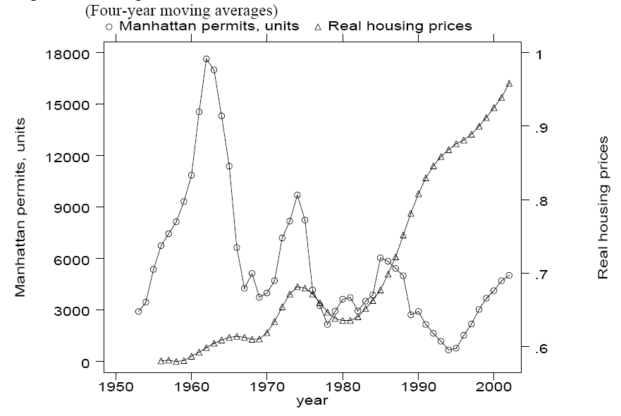

Slide 19
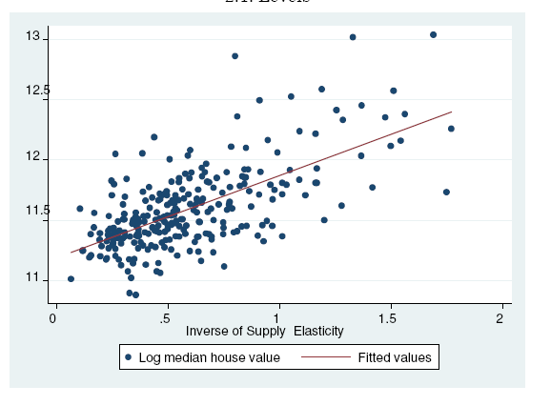
Saiz, Geography and Regulations

Slide 20
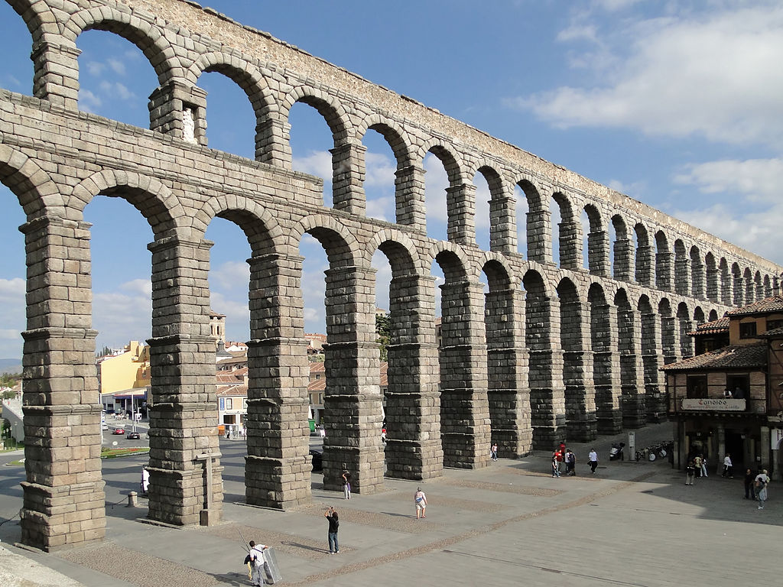
Technology and the City
Photo by Bernard Gagnon

Slide 21
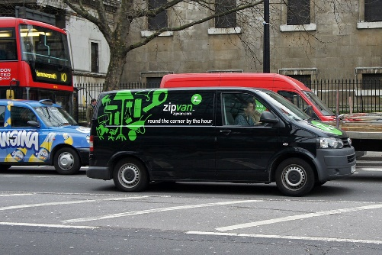
The Sharing Economy: Zipcar
Photo by Mario Roberto Duran Ortiz

Slide 22
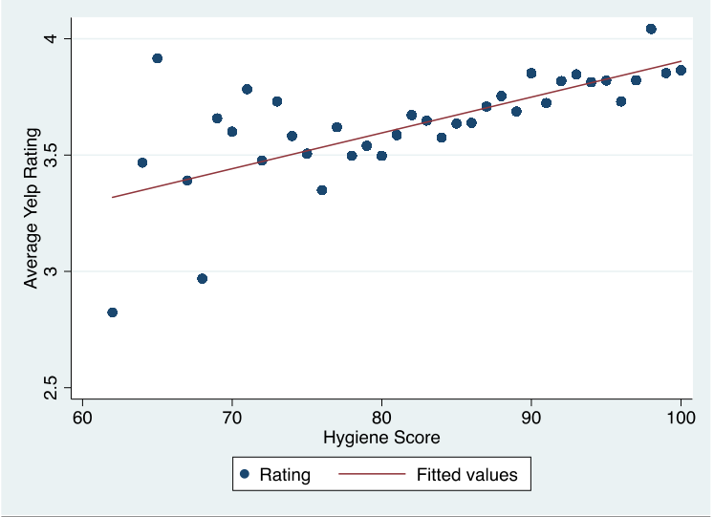
Improving City Services with Yelp Ratings:
Predict Hygiene Scores

Slide 23
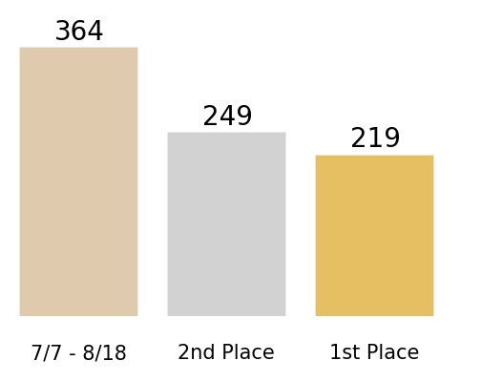
Gains for Boston from Yelp-based Inspection Algorithms
To catch 3,604 weighted violations, inspect this many restaurants:

Slide 24
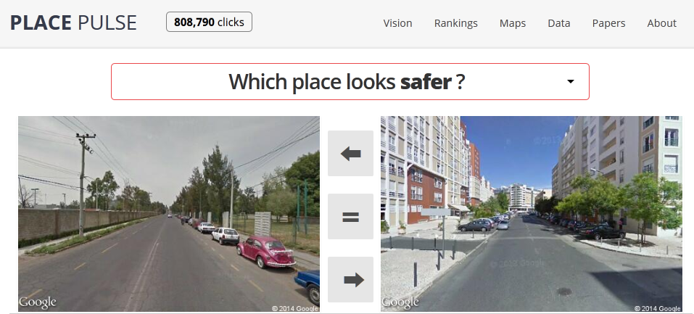
pulse.media.mit.edu
Salesses, Schechtner, and Hidalgo (2013)
Crowdsourced urban appearance survey
Notes:
To train a computer vision algorithm to predict perception, we first need training data. For training this algorithm, we rely on the Place Pulse project, launched by Prof Cesar Hidalgo and colleagues in 2011. In Place Pulse, people are shown a pair of images from Google street view side-by-side and asked to choose one of them in response to questions including “which place looks safer?”, ““which place looks wealthier” and so on.

Slide 25
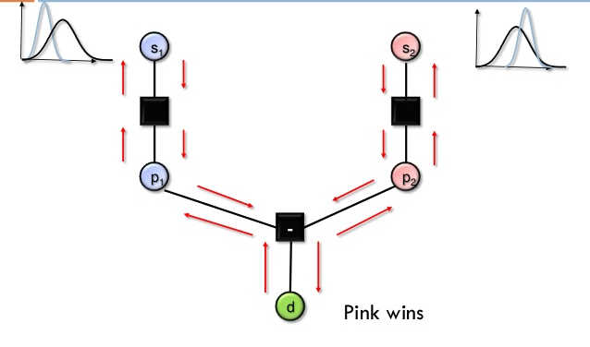
Converting Pairwise Comparisons to Ranked Scores
MIcrosoft Trueskill [Herbrich et al.2007]
Notes:
Anyway, now that we have these pairwise comparisons, we want to convert them to numerical scores. For this purpose, we used a variation of the Microsoft Trueskill algorithm. Trueskill is a Bayesian rating system used to rank players in online games. In our case, each image is a player in a two-player contest, whose winner is decided by the human contributor. All the images start with the same initial score, represented as a Gaussian variable. Their score is updated after every click.

Slide 26
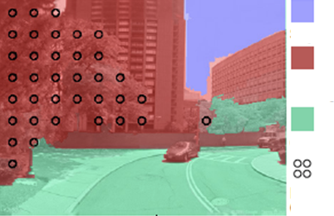
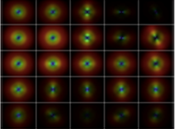
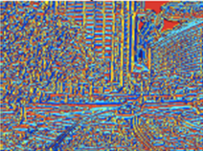
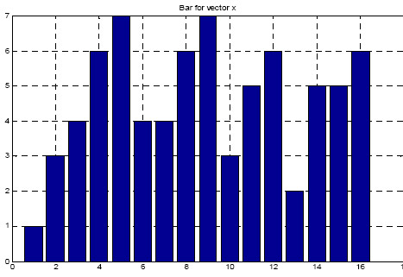
Sky
Building
Image Features
Ground
Trees
CIELAB
Color Histograms
GIST
Texton Maps
Notes:
The three features quantify things like colors, textures and shapes that are present in the image. In other words, they try to quantify things like the greenness of the grass, roughness of the bricks, and pointiness of the roof.

Slide 27
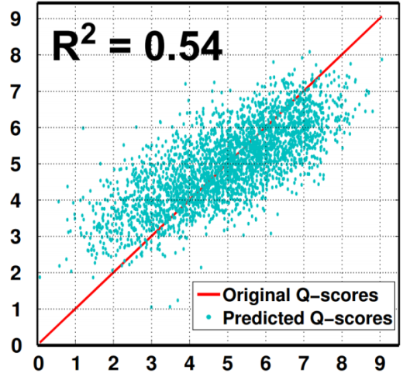
Prediction Performance
R² = 0.54
True Streetscore
Predicted Streetscore
Notes:
The support vector regression does pretty well. We an R^2 of 0.54 between the true and predicted scores. So generic image features are able to predict human perceptual response from the place pulse dataset.

Slide 28
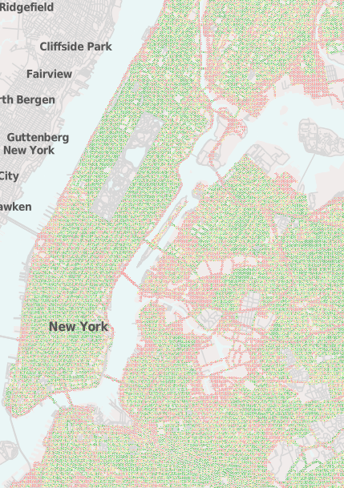
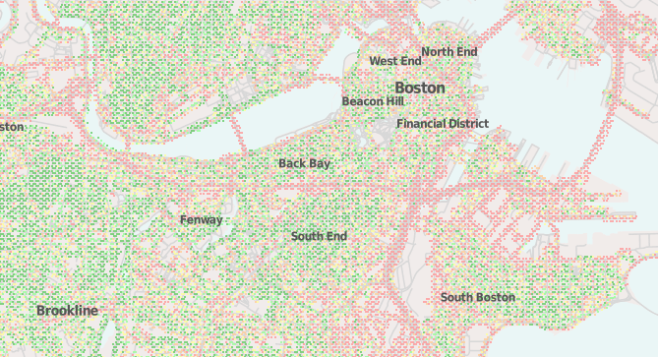
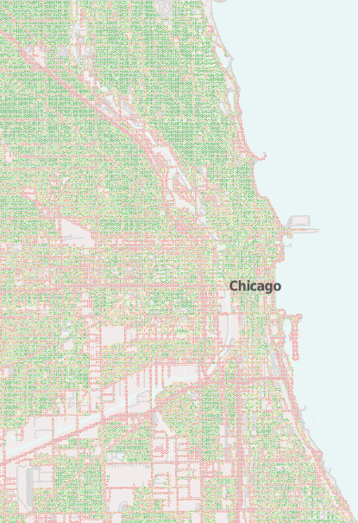
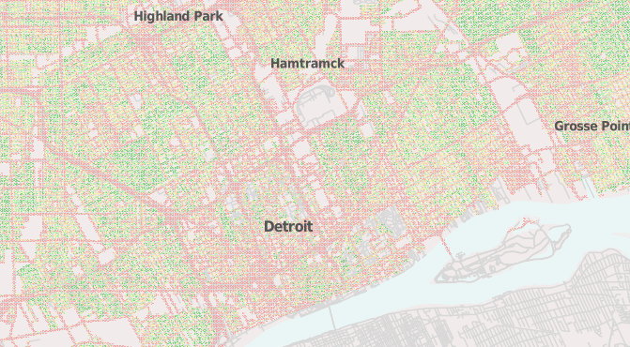
New York
Boston
Chicago
Detroit
Available at streetscore.media.mit.edu
Notes:
The website currently has visualizations for five major American cities, including New York, Boston, Chicago and Detroit.

Slide 29
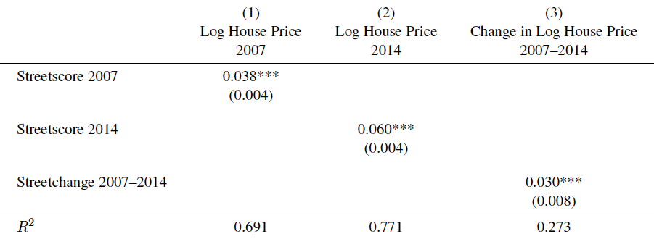
Neighborhoods with Higher “Streetscores” have higher prices

Slide 30
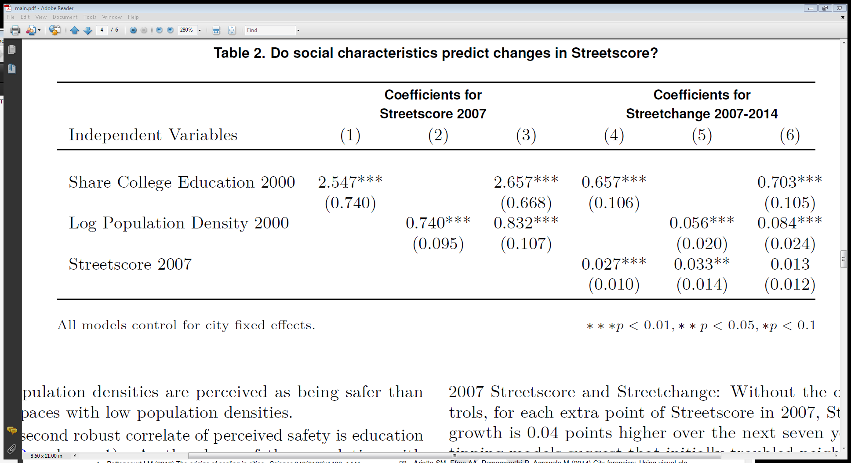
Predicting Neighborhood Change

Slide 31
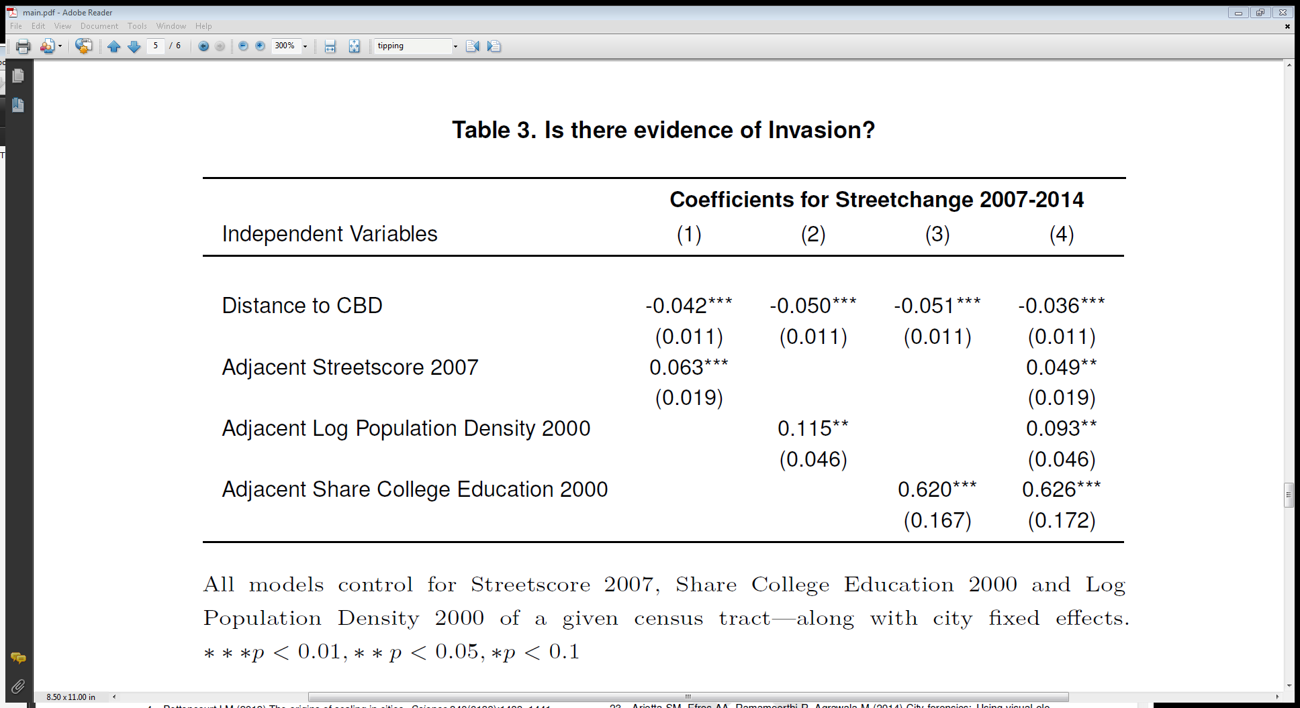
The Slow Spread of Success

Slide 32
Ongoing Work: Boston Property Prices Dataset
Glaeser, Kincaid, Naik
47918 Single Family Homes, 25723 condominiums from Greater Boston area.
Sold between 1986-2016
Includes data on both physical characteristics, and subjective measures of quality from city assessor’s office.
Includes “Streetscore” measures for all properties, evaluated from images captured between 2009 and 2014.

Slide 33
Assessors vs. Streetview Images
Control Variables | Goodness of Fit (R-Squared)
BASIC CONTROLS (e.g. number of rooms) | 17.3%
BASIC CONTROLS PLUS ASSESSOR | 26.5%
BASIC CONTROLS PLUS STREETVIEW | 25.1%
BASIC CONTROLS PLUS ASSESSOR + STREETVIEW | 30.9%

Slide 34
Visual Imagery Can Assess Old Standing Questions about housing?
How much visual value comes from remodelling (asnwer in Boston: 23,500 for single families).
Do owners take better care of their homes than renters?
Does foreclosure lead to a deterioration in the physical stock of housing?
Are the resold houses that make up the Case-Shiller index better maintained – which could cause the index to be biased upwards?

Slide 35
Results
We compare the visual images of Boston homes in 2007 and 2014 – comparing foreclosed and not-foreclosed homes.
We use propensity score matching to match the foreclosed homes with similar homes in 2007.
We find that the foreclosed homes in Boston lose $11,600 worth of value relative to the control sample.
Effect is larger ($13,000) if we exclude homes that have been remodeled.

Slide 36
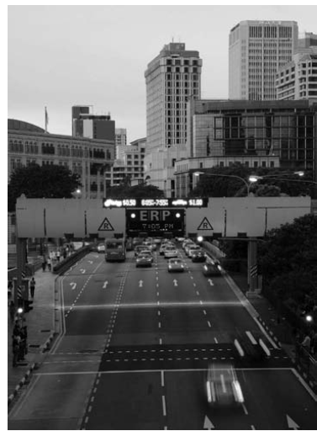
Autonomous Vehicles and Cities

Slide 37
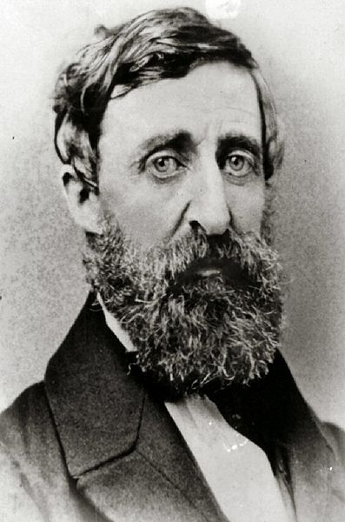
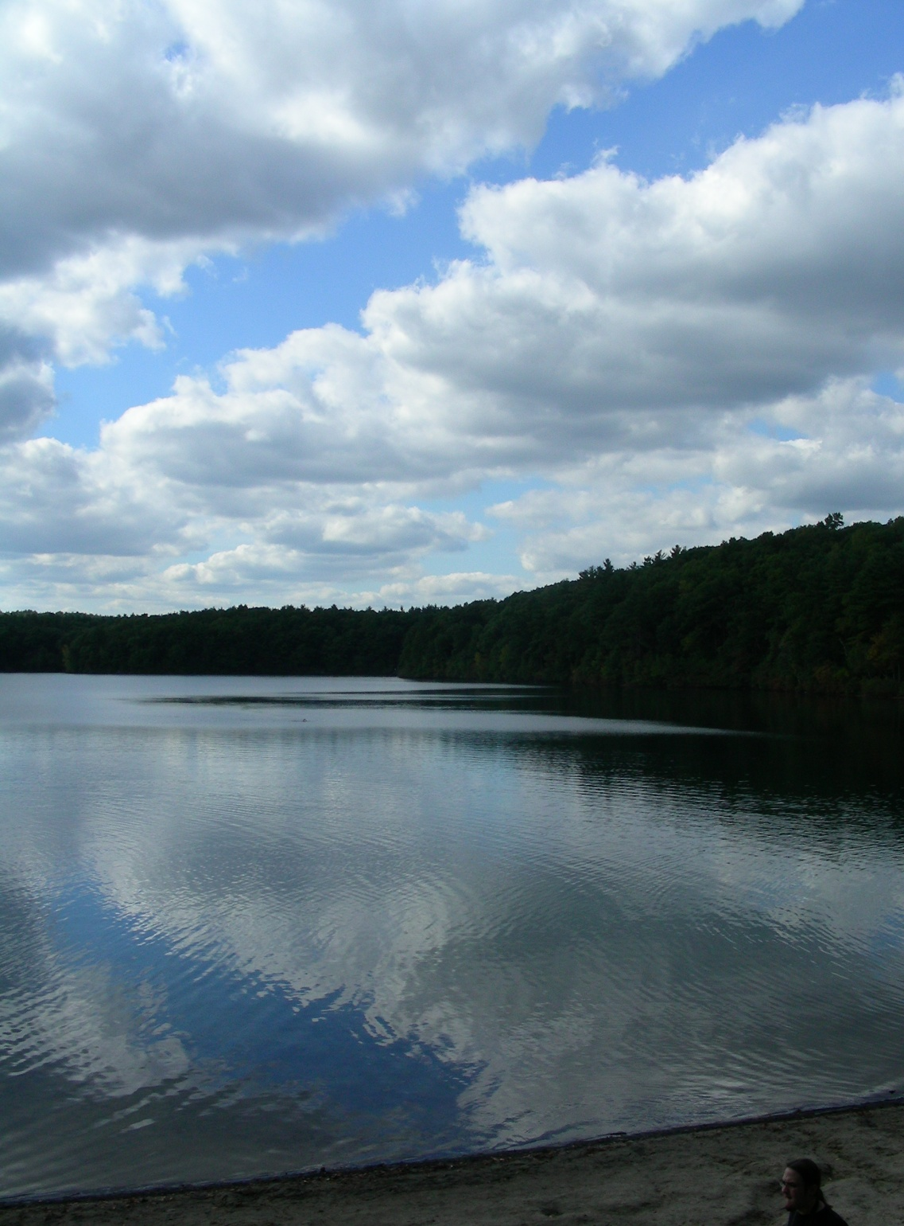
Image by QuarterCircleS

Slide 38
