Slide 1
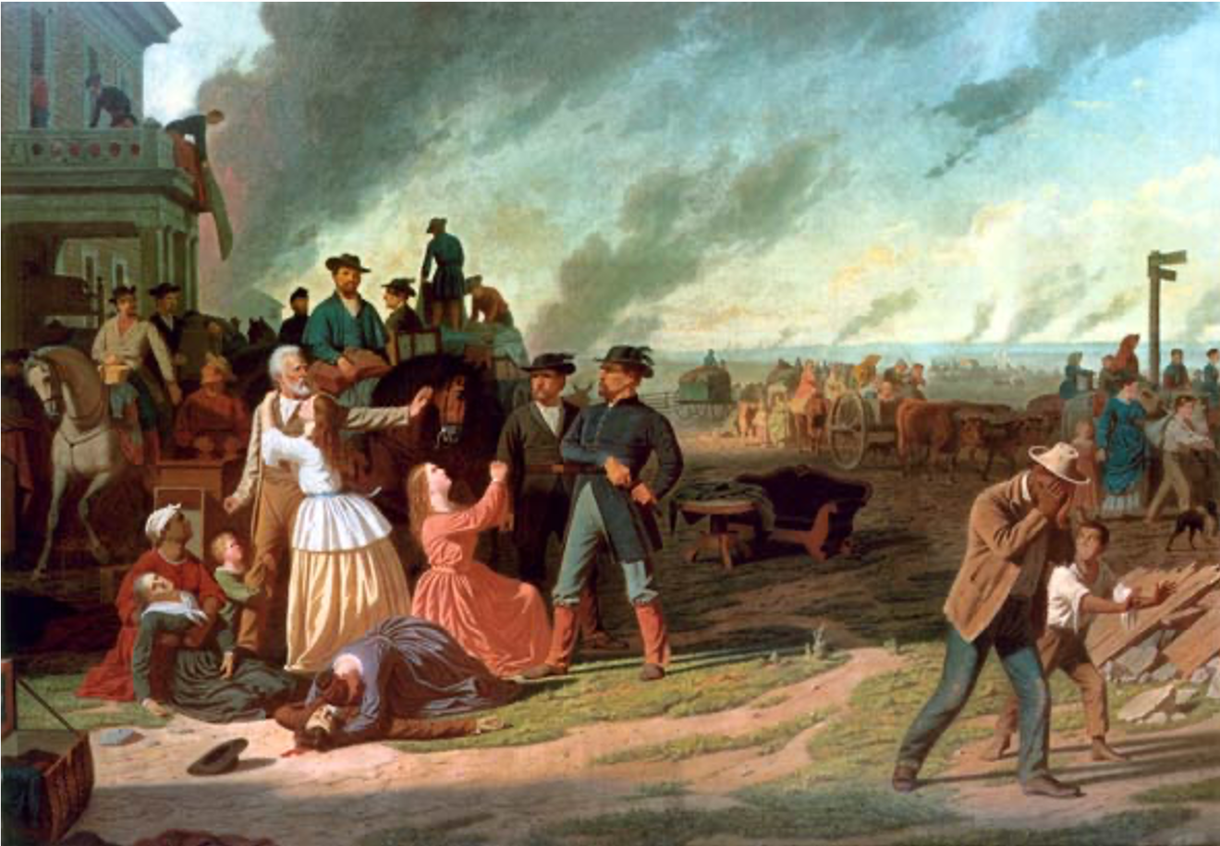
Adapting Your Course to the Discovery Tier
HIST 3104: The Era of the Civil War

Slide 2
Checklist for Disco Tier Classes:
Every syllabus for a Discovery Tier-course must clearly and explicitly situate the course within the Discovery Tier. This helps our students identify meaningful connections across their Discovery Tier classes and integrate different disciplinary approaches to their selected theme. It also creates a more consistent student experience and aids in the required curricular assessment process.
More specifically, every syllabus must include each of the elements identified below. Faculty teaching courses in the Discovery Tier are required to use the following checklist to ensure that they have included these items, and to highlight the relevant portions of the syllabus in copies submitted to the MCC Committee. Faculty assistance on this important manner is greatly appreciated.
A prominently-placed paragraph identifying the course as a Discovery Tier-course and linking the course topic to the Discovery theme.
At least one course-specific learning objective that indicates student learning expectations related to the Discovery theme. The learning outcome makes this connection to the theme explicit.
A brief description of the assignments (e.g., readings, activities, papers, exam questions, etc.) that explicitly ask students to make substantive connections between the course topic and the Discovery theme.
The previous three elements have all been highlighted in the syllabus submitted to the MCC committee.
To assist faculty, sample syllabi that have followed these instructions are available on the MCC website: https://www.marquette.edu/core-curriculum/information-for-faculty-and-advisers.php

Slide 3
Individuals and Communities, Pt. 1
The nature of the relationship between the individual and the community remains a perennial question, at the heart of technological, political, religious and ecological thought. One cannot understand prominent human trends — like the tendency, both in history and in the present day, to cluster populations in urban environments — without attending to the longings of the individual for community and the reliance of the community on the individual. Yet the relationship between these two is fraught with ambiguity and tension. On the one hand, communities have amplified humanity’s potential to overcome injustice, suffering and human limitations. Communities have enabled individuals to mobilize, innovate and act collectively for the common good. On the other hand, communities have also identified, stigmatized and exterminated outsiders. By utilizing tools of oppression, such as prejudice and discrimination, communities have also stifled progress and catered to fears, bigotry and hatred.

Slide 4
Individuals and Communities, Pt. 2
To explore these ideas, courses in this theme might focus on specific communities, such as the Marquette University community; they might examine individual cities, like Milwaukee, as geographically defined communities that have shaped — and been shaped by — the individuals who live there; or they might refer to community as a unit of analysis more generally to examine “community-level” processes such as racial segregation, civic engagement, public education, small business development, health care and civil engineering. Courses congruent with this theme are not restricted to any single understanding or definition of “community” and instead will consider communities of many kinds and scales, and with many purposes: religious, political, intellectual, geographical, ecological or virtual, to name only few.

